Slide 1

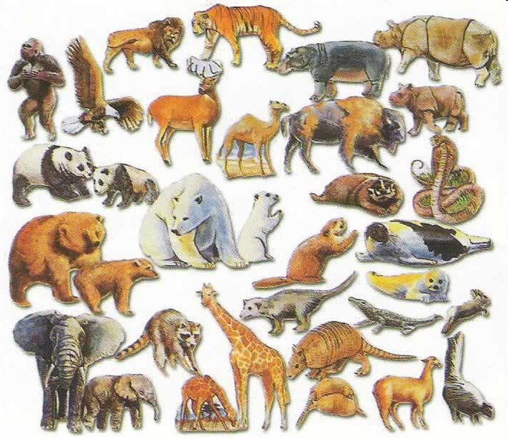

Interface Inheritance
Introduction to Computer Science
Shimon Schocken
IDC Herzliya
Lecture 12-2

Slide 2
Inheritance
Background
Inheritance is a major feature of object-oriented programming
Lectures 12-1, 12-2 provide an introduction to inheritance
Focusing on main concepts and techniques.
Two forms of inheritance
Class inheritance (lecture 12-1)
Interface inheritance (lecture 12-2)

Slide 3
Lecture plan
Using interfaces for:
Type hierarchy
Polymorphism (managing heterogeneous objects)
Standardization (building and using classes consistently)
Multiple inheritance

Slide 4

Type hierarchy
The challenge (example)
We are developing a simple Animals Game
We’ll focus on the sounds that animals make, and the food they eat
Let the user select the animals for the game, from a supply of available animals.

Slide 5
Type hierarchy
An interface specifies a contract:
/** Animal interface for a simple Animals Game */
public interface Animal {
/** Returns the sound that this animal makes */
public String sound();
/** Returns the food that this animal eats */
public Object eats();
}
Type Hierarchy:
Design decision (software engineering)
We’ll build a type hierarchy:
Use an interface to represent the common behavior of all the animal types
Use regular classes to represent the specific behaviors and properties of each animal type
(behavior = methods, properties = fields)
Animal
interface
is-a
Dog
Cow
Mouse
regular classes
is-a
max
scooby
(objects)

Slide 6
Type hierarchy
An interface specifies a contract:
Every object of type Animal must be able to do at least two things (for this game):
Make a sound
Return the food it eats
Implication: every class that is-an Animal must implement at least the methods sound() and eats()
/** Animal interface for a simple Animals Game */
public interface Animal {
/** Returns the sound that this animal makes */
public String sound();
/** Returns the food that this animal eats */
public Object eats();
}
Type Hierarchy:
Design decision (software engineering)
We’ll build a type hierarchy:
Use an interface to represent the common behavior of all the animal types
Use regular classes to represent the specific behaviors and properties of each animal type
(behavior = methods, properties = fields)
Animal
interface
is-a
Dog
Cow
Mouse
regular classes
is-a
max
scooby
(objects)

Slide 7
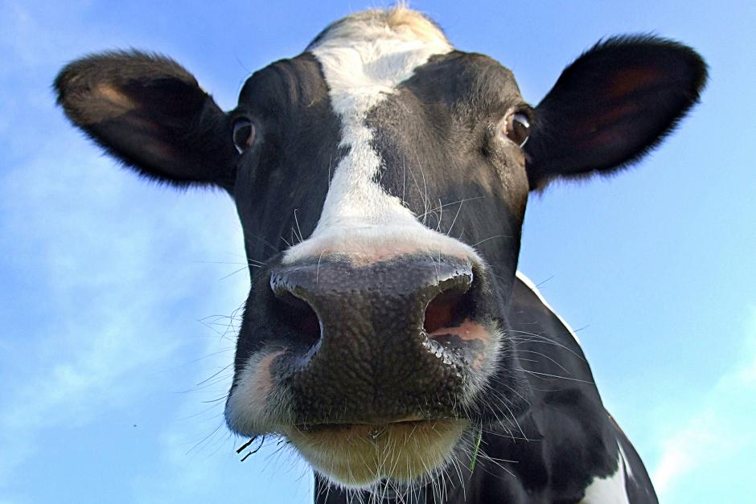
Cow
An interface specifies a contract:
Every object of type Animal must be able to do at least two things (for this game):
Make a sound
Return the food it eats
Implication: every class that is-an Animal must implement at least the methods sound() and eats()
/** Animal interface for a simple Animals Game */
public interface Animal {
/** Returns the sound that this animal makes */
public String sound();
/** Returns the food that this animal eats */
public Object eats();
}
/** A Cow */
public class Cow implements Animal {
“is-an” Animal
Notes:
7

Slide 8
Cow
An interface specifies a contract:
Every object of type Animal must be able to do at least two things (for this game):
Make a sound
Return the food it eats
Implication: every class that is-an Animal must implement at least the methods sound() and eats()
/** Animal interface for a simple Animals Game */
public interface Animal {
/** Returns the sound that this animal makes */
public String sound();
/** Returns the food that this animal eats */
public Object eats();
}
/** A Cow */
public class Cow implements Animal {
String food = "hay";
int weight;
/** Constructs a cow. */
public Cow(int weight) {
this.weight = weight;
}
/** The sound of this cow. */
public String sound() { return "moo"; }
/** The food of this cow. */
public String eats() { return food; }
/** The weight of this cow */
public double weight() { return weight; }
}
“is-an” Animal
// Client code, in any class:
Cow c = new Cow();
System.out.println(c.sound());
moo
Notes:
8

Slide 9
Interface: the rules of the game
/** Animal interface for a simple Animals Game */
public interface Animal {
/** Returns the sound that this animal makes */
public String sound();
/** Returns the food that this animal eats */
public Object eats();
}
/** A Cow */
public class Cow implements Animal {
String food = "hay";
int weight;
/** Constructs a cow. */
public Cow(int weight) {
this.weight = weight;
}
/** The sound of this cow. */
public String sound() { return "moo"; }
/** The food of this cow. */
public String eats() { return food; }
/** The weight of this cow */
public double weight() { return weight; }
}
Notes:
9

Slide 10
Interface: the rules of the game
/** Animal interface for a simple Animals Game */
public interface Animal {
/** Returns the sound that this animal makes */
public String sound();
/** Returns the food that this animal eats */
public Object eats();
}
Abstract method:
A method signature without an implementation
An interface:
Defines a minimal behavior that each instance of the type must have
The behavior is specified using abstract methods
Has a regular API
Compiled just like a class
BUT: An interface cannot be instantiated (no fields, no constructors, no new Animal)
/** A Cow */
public class Cow implements Animal {
String food = "hay";
int weight;
/** Constructs a cow. */
public Cow(int weight) {
this.weight = weight;
}
/** The sound of this cow. */
public String sound() { return "moo"; }
/** The food of this cow. */
public String eats() { return food; }
/** The weight of this cow */
public double weight() { return weight; }
}
Classes that implement the interface:
Are regular classes
Must implement every method listed in the interface
(or get a compilation error)
Normally define additional methods.
Notes:
10

Slide 11

Dog
/** Animal interface for a simple Animals Game */
public interface Animal {
/** Returns the sound that this animal makes */
public String sound();
/** Returns the food that this animal eats */
public Object eats();
}
/** A dog. */
public class Dog implements Animal {

Slide 12
Dog
/** Animal interface for a simple Animals Game */
public interface Animal {
/** Returns the sound that this animal makes */
public String sound();
/** Returns the food that this animal eats */
public Object eats();
}
/** A dog. */
public class Dog implements Animal {
String food = "bonzo";
/** Constructs a dog. */
public Dog() {
}
/** The sound of this dog. */
public String sound() { return "woof"; }
/** The food of this dog. */
public String eats() { return food; }
}
// Client code, in any class:
Dog d = new Dog();
System.out.println(d.sound());
woof

Slide 13
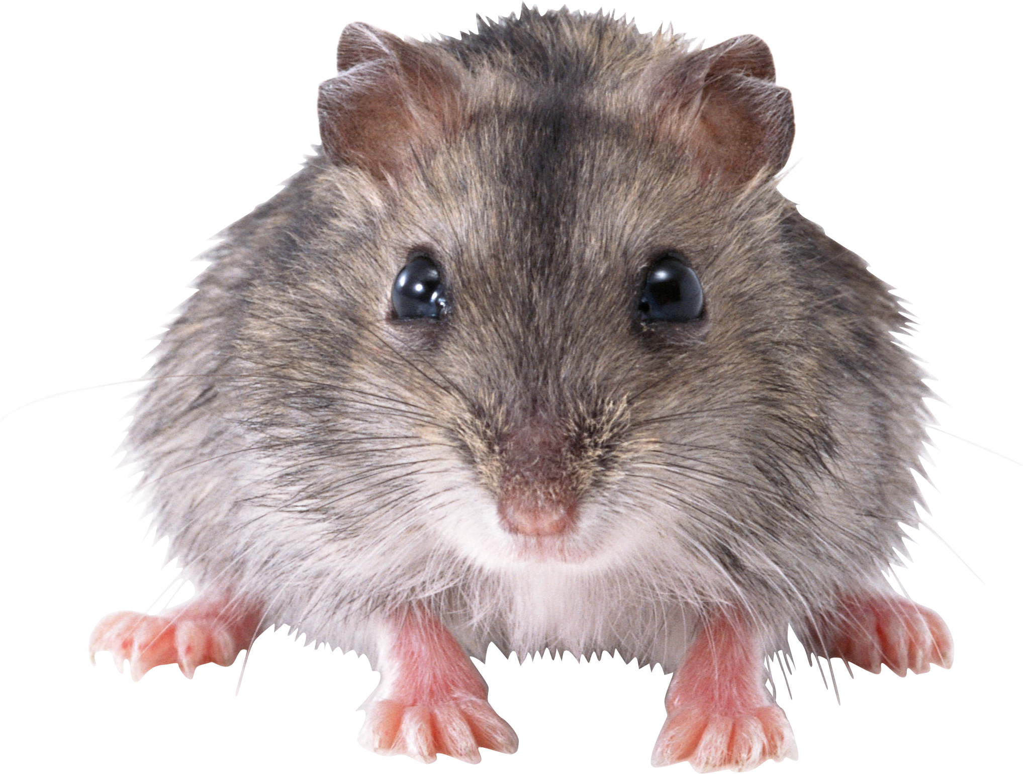
Mouse
/** Animal interface for a simple Animals Game */
public interface Animal {
/** Returns the sound that this animal makes */
public String sound();
/** Returns the food that this animal eats */
public Object eats();
}
/** A mouse. */
public class Mouse implements Animal {
String food = "crumbs";
/** Constructs a mouse. */
public Mouse() {}
/** The sound of this mouse. */
public String sound() { return "squeak"; }
/** The food of this mouse. */
public String eats() { return food; }
/** Sets the food of this mouse */
public void setFood(String food) {
this.food = food; }
}
// Client code, in any class:
Mouse m = new Mouse();
System.out.println(m.sound());
squeak

Slide 14
Boa
/** Animal interface for a simple Animals Game */
public interface Animal {
/** Returns the sound that this animal makes */
public String sound();
/** Returns the food that this animal eats */
public Object eats();
}
The interface designer made the type of the return value of eats() intentionally “wide”
That’s because different animals eat many different things, including animals.
/** A boa. */
public class Boa implements Animal {

Slide 15
Boa
/** Animal interface for a simple Animals Game */
public interface Animal {
/** Returns the sound that this animal makes */
public String sound();
/** Returns the food that this animal eats */
public Object eats();
}
The interface designer made the type of the return value of eats() intentionally “wide”
That’s because different animals eat many different things, including animals.
/** A boa. */
public class Boa implements Animal {
// The food of this boa
Animal food;
/** Constructs a boa and feeds it right away */
public Boa(Animal a) {
food = a;
}
/** The sound that this boa makes. */
public String sound() {
return "((" + food.sound() + "))";
}
/** The food of this boa. */
public Animal eats() { return food; }
}
// Client code, in any class:

Slide 16
Boa
/** Animal interface for a simple Animals Game */
public interface Animal {
/** Returns the sound that this animal makes */
public String sound();
/** Returns the food that this animal eats */
public Object eats();
}
The interface designer made the type of the return value of eats() intentionally “wide”
That’s because different animals eat many different things, including animals.
/** A boa. */
public class Boa implements Animal {
// The food of this boa
Animal food;
/** Constructs a boa and feeds it right away */
public Boa(Animal a) {
food = a;
}
/** The sound that this boa makes. */
public String sound() {
return "((" + food.sound() + "))";
}
/** The food of this boa. */
public Animal eats() { return food; }
}
// Client code, in any class:
Boa b1 = new Boa(new Mouse());
System.out.println(b1.sound());
Boa b2 = new Boa(b1);
System.out.println(b2.sound());
((squeak))

Slide 17
Boa
/** Animal interface for a simple Animals Game */
public interface Animal {
/** Returns the sound that this animal makes */
public String sound();
/** Returns the food that this animal eats */
public Object eats();
}
The interface designer made the type of the return value of eats() intentionally “wide”
That’s because different animals eat many different things, including animals.
/** A boa. */
public class Boa implements Animal {
// The food of this boa
Animal food;
/** Constructs a boa and feeds it right away */
public Boa(Animal a) {
food = a;
}
/** The sound that this boa makes. */
public String sound() {
return "((" + food.sound() + "))";
}
/** The food of this boa. */
public Animal eats() { return food; }
}
// Client code, in any class:
Boa b1 = new Boa(new Mouse());
System.out.println(b1.sound());
Boa b2 = new Boa(b1);
System.out.println(b2.sound());
((squeak))
((((squeak))))

Slide 18
Interfaces: Recap
/** Animal interface for a simple Animals Game */
public interface Animal {
/** Returns the sound that this animal makes */
public String sound();
/** Returns the food that this animal eats */
public Object eats();
}
An interface:
Defines a minimal behavior that each instance of the type must have
The behavior is specified using public abstract methods
Has a regular API
Compiled just like a class
BUT: An interface cannot be instantiated (no fields, constructors, no new Animal)
/** A boa. */
public class Boa implements Animal {
// The food of this boa
Animal food;
/** Constructs a boa and feeds it right away */
public Boa(Animal a) {
food = a;
}
/** The sound that this boa makes. */
public String sound() {
return "((" + food.sound() + "))";
}
/** The food of this boa. */
public Animal eats() { return food; }
}
Classes that implement the interface:
Are regular classes
Must implement every method listed in the interface
(or get a compilation error)
Normally define additional methods.

Slide 19
Lecture plan
Using interfaces for:
Type hierarchy
Polymorphism (managing objects heterogeneously)
Standardization (building and using classes consistently)
Multiple inheritance

Slide 20
Polymorphism
// Client code, in some class:
Animal
interface
is-a
Dog
Cow
classes
is-a
puff
pua
objects

Slide 21
Polymorphism
// Client code, in some class:
// Creates some animals and plays their sounds.
Cow pua = new Cow(500);
Dog puff = new Dog();
System.out.println(pua.sound());
System.out.println(puff.sound());
makeSoundTwice(pua);
makeSoundTwice(puff);
Animal
interface
moo
woof
is-a
Dog
Cow
classes
is-a
puff
pua
objects

Slide 22
Polymorphism
// Client code, in some class:
// Creates some animals and plays their sounds.
Cow pua = new Cow(500);
Dog puff = new Dog();
System.out.println(pua.sound());
System.out.println(puff.sound());
makeSoundTwice(pua);
makeSoundTwice(puff);
private static void makeSoundTwice(Animal a) {
System.out.println(a.sound() + " " + a.sound());
}
Animal
interface
moo
woof
moo moo
woof woof
is-a
Dog
Cow
classes
upcasting
is-a
puff
pua
objects
Polymorphic processing
“Polymorphic method”: Takes an Animal object as a parameter (Animal is an interface)
Thus, we can call this method on any object of type Animal
Notice: During compile time, when we call sound(), we’re not sure which method we’re calling

Slide 23
Polymorphism: heterogeneous collections
// Creates a heterogeneous array of Animal objects:

Slide 24
Polymorphism: heterogeneous collections
// Creates a heterogeneous array of Animal objects:
Animal[] animals = { new Cow(500), new Dog(), new Mouse() };
for (Animal a : animals) {
System.out.println(a.getClass().getName()+ " goes " + a.sound());
}
Cow goes moo
Dog goes woof
Mouse goes squeak
getClass(): an Object class method that returns a Class object that represents the class to which the object belongs
getName(): a Class method that returns the name of the class, as a string

Slide 25
Polymorphism: heterogeneous collections
Old MacDonald had a farm, E-I-E-I-O
And on this farm he had a Cow, E-I-E-I-O
With a moo here and a moo there
Here a moo there a moo
Everywhere a moo moo
Old MacDonald had a farm, E-I-E-I-O
Old MacDonald had a farm, E-I-E-I-O
And on this farm he had a Dog, E-I-E-I-O
With a woof here and a woof there
Here a woof there a woof
Everywhere a woof woof
Old MacDonald had a farm, E-I-E-I-O
Old MacDonald had a farm, E-I-E-I-O
And on this farm he had a Mouse, E-I-E-I-O
With a squeak here and a squeak there
Here a squeak there a squeak
Everywhere a squeak squeak
Old MacDonald had a farm, E-I-E-I-O
Task:
Produce an Old MacDonald song for a farm of animals
Let the user decide which animals will be in the farm / song.

Slide 26
Polymorphism: heterogeneous collections
public static void main(String[] args) {

Slide 27
Polymorphism: heterogeneous collections
public static void main(String[] args) {
Animal[] farm = { new Cow(500), new Dog(), new Mouse() }; // put here any animal you want
for (Animal animal : farm)
oldMacDonaldVerse(animal);
}
private static void oldMacDonaldVerse(Animal animal) {
String eieio = ", E-I-E-I-O";
System.out.println("Old MacDonald had a farm" + eieio);
System.out.println("And in this farm he had a " + animal.getClass().getName() + eieio);
String sound = animal.sound();
System.out.println("With a " + sound + " here and a " + sound + " there" );
System.out.println( "Here a " + sound + " there a " + sound);
System.out.println("Everywhere a " + sound + " " + sound);
System.out.println("Old MacDonald had a farm" + eieio);
}
Old MacDonald had a farm, E-I-E-I-O
And on this farm he had a Cow, E-I-E-I-O
With a moo here and a moo there
Here a moo there a moo
Everywhere a moo moo
Old MacDonald had a farm, E-I-E-I-O
typical output of oldMacDonaldVerse()

Slide 28
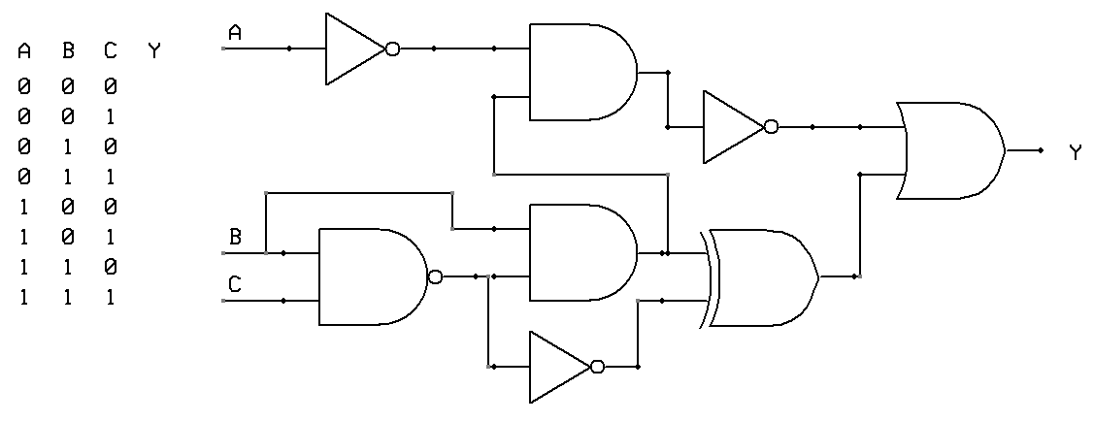
Polymorphism: heterogeneous collections
/** Logic gate interface */
public interface Gate {
/** Returns the value of this gate */
public boolean eval(List<Gate> inputs);
/** Draws this gate */
public void draw();
}
public AndGate implements Gate {
// Fields and constructors come here
public boolean eval(...) {...}
public void draw() {...}
// More AndGate methods
}
Notice that every logic gate “inherits” all the methods of the Gate interface.
public OrGate implements Gate {
// Fields and constructors come here
public boolean eval(...) {...}
public void draw() {...}
// More OrGate methods
}
public NotGate implements Gate {
// Fields and constructors come here
public boolean eval(...) {...}
public void draw() {...}
// More NotGate methods
}
Hardware simulator:
Used to construct, evaluate, and draw chips
...
Not
And
Not
Or
And
And
Xor
Not

Slide 29
Virtual method calling
Animal a;
Animal
interface
is-a
Dog
Cow
classes

Slide 30
Virtual method calling
Animal a;
Cow c = new Cow(500);
Dog d = new Dog();
// The following code serves no purpose,
// except for illustrating virtual method calling
a = c; // Downcasting a: Treats a as a Cow
System.out.println(a.sound());
a = d; // Downcasting a: Treats a as a Dog
System.out.println(a.sound());
Animal
interface
is-a
Dog
Cow
classes
moo
woof
Observation:
During compile-time, we have two identical method calls: a.sound()
But during run-time, we end up calling two different methods:
In one case a.sound() results in calling the sound() method of class Cow
In another case a.sound() results in calling the sound() method of class Dog
Virtual method calling / Late Binding:
In Java, objects have runtime types
Which method to invoke on an object is determined during run-time, according to the object’s run-time type

Slide 31
Lecture plan
Using interfaces for:
Type hierarchy
Polymorphism (managing objects heterogeneously)
Standardization (building and using classes consistently)
Multiple inheritance

Slide 32
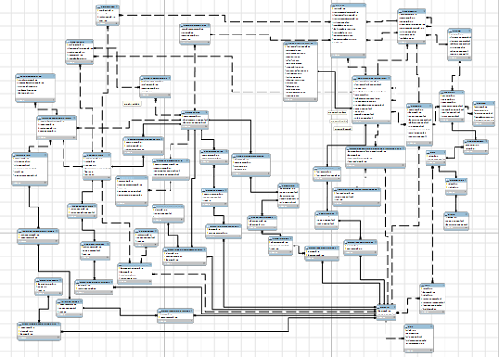
Managing software complexity
The problem
Large software systems consist of many classes, built by (possibly) many developers
The classes are made to interact with each other
How to reduce complexity?
Consistency!
Good systems are characterized by common design rules, constraints, and terminology
These standards can be articulated, documented, and enforced using interfaces.

Slide 33
Managing software complexity
Object comparison (example)
How to compare strings? dates? fractions? sets? polynomials? …
The comparisons are application- and class-specific
However, object comparisons can be standardized:
For this purpose, Java provides an interface named Comparable
Best practice:
When you design a class that represents a type that has a natural order (Fraction, Date, …)
Have the class implement Java’s Comparable interface
This way, code that creates and manages collections of the class objects will be able to use standard sorting tools (and many other things that rely on order).

Slide 34
Managing software complexity
Comparable interface
Arrays class
/** Imposes a total ordering on the objects of each class that implements it.
Objects are compared using the compareTo method.
Lists and arrays of objects that implement this interface can be sorted
automatically by the Arrays.sort method. */
public interface Comparable<T> {
/** Compares this object with the other object.
Returns a negative integer, zero, or a positive integer as this
object is less than, equal to, or greater than the other object. */
public int compareTo(T other);
}
/** A library of array processing functions */
public class Arrays
...
/** Sorts the array of objects into ascending order, according to the natural ordering of its elements. The array elements must implement the Comparable interface. */
static public void sort(Object[] arr)
...
From Java’s standard class library

Slide 35
Managing software complexity
Comparable interface
Arrays class
/** Imposes a total ordering on the objects of each class that implements it.
Objects are compared using the compareTo method.
Lists and arrays of objects that implement this interface can be sorted
automatically by the Arrays.sort method. */
public interface Comparable<T> {
/** Compares this object with the other object.
Returns a negative integer, zero, or a positive integer as this
object is less than, equal to, or greater than the other object. */
public int compareTo(T other);
}
/** A library of array processing functions */
public class Arrays
...
/** Sorts the array of objects into ascending order, according to the natural ordering of its elements. The array elements must implement the Comparable interface. */
static public void sort(Object[] arr)
...
Fraction class:
public class Fraction implements Comparable<Fraction> {
private int numerator;
private int denominator;
// Fraction constructors and methods
...

Slide 36
Managing software complexity
Comparable interface
Arrays class
/** Imposes a total ordering on the objects of each class that implements it.
Objects are compared using the compareTo method.
Lists and arrays of objects that implement this interface can be sorted
automatically by the Arrays.sort method. */
public interface Comparable<T> {
/** Compares this object with the other object.
Returns a negative integer, zero, or a positive integer as this
object is less than, equal to, or greater than the other object. */
public int compareTo(T other);
}
/** A library of array processing functions */
public class Arrays
...
/** Sorts the array of objects into ascending order, according to the natural ordering of its elements. The array elements must implement the Comparable interface. */
static public void sort(Object[] arr)
...
Fraction class:
Client code:
public class Fraction implements Comparable<Fraction> {
private int numerator;
private int denominator;
// Fraction constructors and methods
...
/** Compares this fraction with the other fraction. Returns 0, 1, or -1
as this fraction equals, is greater than, or less than, the other fraction. */
public int compareTo(Fraction other) {
if (this.equals(other)) return 0;
int lhs = numerator * other.denominator;
int rhs = other.numerator * denominator;
if (lhs > rhs) return 1;
else return -1;
}
}
// Creates an array of 1000 fractions
Fraction[] fracs = new Fraction[1000];
for (int i = 0; i < fracs.length; i++)
fracs[i] = // Constructs / reads 1000 fractions
// (code omitted)
}

Slide 37
Managing software complexity
Comparable interface
Arrays class
/** Imposes a total ordering on the objects of each class that implements it.
Objects are compared using the compareTo method.
Lists and arrays of objects that implement this interface can be sorted
automatically by the Arrays.sort method. */
public interface Comparable<T> {
/** Compares this object with the other object.
Returns a negative integer, zero, or a positive integer as this
object is less than, equal to, or greater than the other object. */
public int compareTo(T other);
}
/** A library of array processing functions */
public class Arrays
...
/** Sorts the array of objects into ascending order, according to the natural ordering of its elements. The array elements must implement the Comparable interface. */
static public void sort(Object[] arr)
...
Fraction class:
Client code:
public class Fraction implements Comparable<Fraction> {
private int numerator;
private int denominator;
// Fraction constructors and methods
...
/** Compares this fraction with the other fraction. Returns 0, 1, or -1
as this fraction equals, is greater than, or less than, the other fraction. */
public int compareTo(Fraction other) {
if (this.equals(other)) return 0;
int lhs = numerator * other.denominator;
int rhs = other.numerator * denominator;
if (lhs > rhs) return 1;
else return -1;
}
}
// Creates an array of 1000 fractions
Fraction[] fracs = new Fraction[1000];
for (int i = 0; i < fracs.length; i++)
fracs[i] = // Constructs / reads 1000 fractions
// (code omitted)
}
// Sorts the fractions
Arrays.sort(fracs);
for (Fraction f : fracs)
System.out.println(f);
1/250
23/151
14/84
2/15
5/9
6/7
...
In order for the sort to work:
The Fraction class must implement the Comparable interface
Meaning, implement the compareTo method.

Slide 38
Managing software complexity
Comparable interface
Arrays class
/** Imposes a total ordering on the objects of each class that implements it.
Objects are compared using the compareTo method.
Lists and arrays of objects that implement this interface can be sorted
automatically by the Arrays.sort method. */
public interface Comparable<T> {
/** Compares this object with the other object.
Returns a negative integer, zero, or a positive integer as this
object is less than, equal to, or greater than the other object. */
public int compareTo(T other);
}
/** A library of array processing functions */
public class Arrays
...
/** Sorts the array of objects into ascending order, according to the natural ordering of its elements. The array elements must implement the Comparable interface. */
static public void sort(Object[] arr)
...
Fraction class:
Client code (another example):
public class Fraction implements Comparable<Fraction> {
private int numerator;
private int denominator;
// Fraction constructors and methods
...
/** Compares this fraction with the other fraction. Returns 0, 1, or -1
as this fraction equals, is greater than, or less than, the other fraction. */
public int compareTo(Fraction other) {
if (this.equals(other)) return 0;
int lhs = numerator * other.denominator;
int rhs = other.numerator * denominator;
if (lhs > rhs) return 1;
else return -1;
}
}
// Creates an array of 1000 dates
Date[] dates = new Date[1000];
for (int i = 0; i < dates.length; i++)
dates[i] = // Constructs / reads 1000 dates
// (code omitted)
}

Slide 39
Managing software complexity
Comparable interface
Arrays class
/** Imposes a total ordering on the objects of each class that implements it.
Objects are compared using the compareTo method.
Lists and arrays of objects that implement this interface can be sorted
automatically by the Arrays.sort method. */
public interface Comparable<T> {
/** Compares this object with the other object.
Returns a negative integer, zero, or a positive integer as this
object is less than, equal to, or greater than the other object. */
public int compareTo(T other);
}
/** A library of array processing functions */
public class Arrays
...
/** Sorts the array of objects into ascending order, according to the natural ordering of its elements. The array elements must implement the Comparable interface. */
static public void sort(Object[] arr)
...
Fraction class:
Client code (another example):
public class Fraction implements Comparable<Fraction> {
private int numerator;
private int denominator;
// Fraction constructors and methods
...
/** Compares this fraction with the other fraction. Returns 0, 1, or -1
as this fraction equals, is greater than, or less than, the other fraction. */
public int compareTo(Fraction other) {
if (this.equals(other)) return 0;
int lhs = numerator * other.denominator;
int rhs = other.numerator * denominator;
if (lhs > rhs) return 1;
else return -1;
}
}
// Creates an array of 1000 dates
Date[] dates = new Date[1000];
for (int i = 0; i < dates.length; i++)
dates[i] = // Constructs / reads 1000 dates
// (code omitted)
}
// Sorts the dates
Arrays.sort(dates);
for (Date d : dates)
System.out.println(d);
30/07/1746
06/03/1912
01/12/1912
25/01/2019
...
Many Java classes, like Date and String, implement Comparable
Therefore, objects of their type can be easily compared, and sorted.

Slide 40
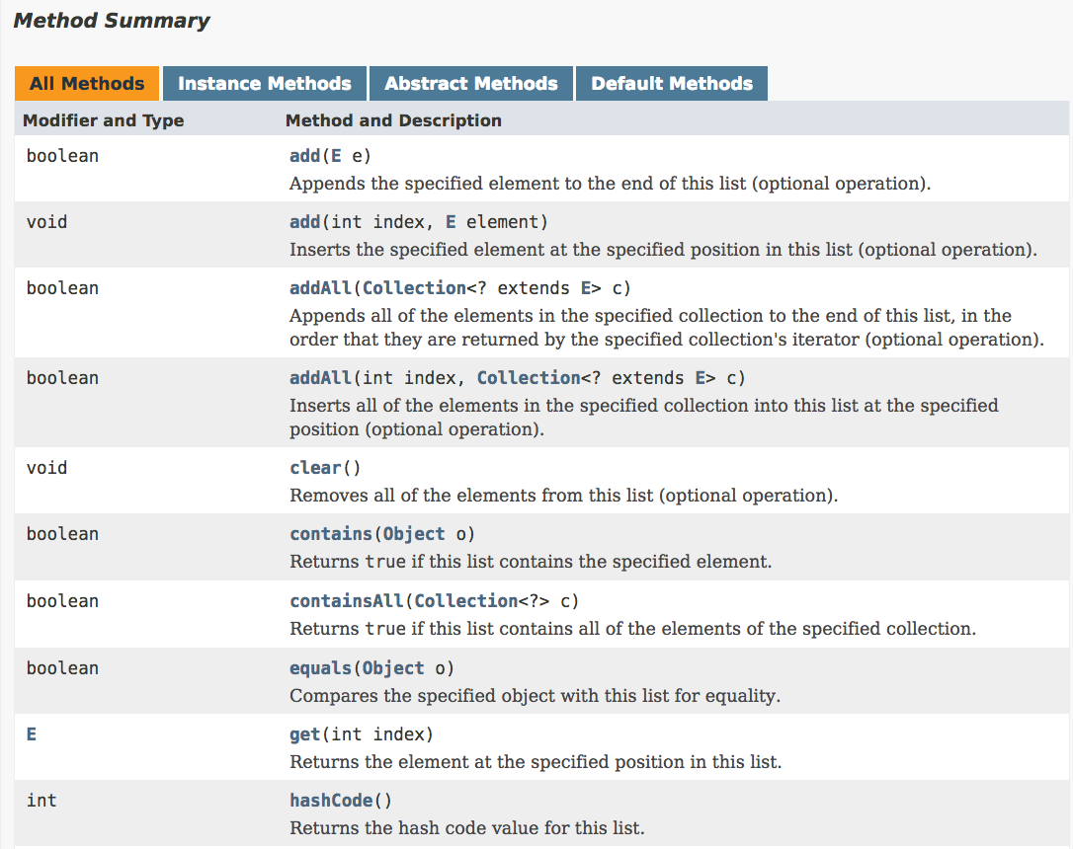
Managing software complexity
What is common to:
LinkedList, ArrayList, Queue, ... And many other classes that implement ordered collections of elements?
They all need to feature (at least) element-oriented operations: add, remove, compare, ...
Interface List<T>:
The List interface features 28 abstract methods for list processing
Best practice: When reading the documentation of an unfamiliar class, start by checking which interfaces it implements
Classes that implement commonly-used interfaces are more consistent, readable, testable, familiar, and usable.
etc...

Slide 41
Lecture plan
Using interfaces for:
Type hierarchy
Polymorphism (managing objects heterogeneously)
Standardization (building and using classes consistently)
Multiple inheritance

Slide 42
Multiple inheritance (in a nutshell)
public interface Animal {
/** Animal methods */
}
public interface Predator {
/** Predator methods */
}
public interface Amphibious {
/** Amphibious methods */
}
public class Alligator implements Animal, Predator, Amphibious {

Slide 43
Multiple inheritance (in a nutshell)
public interface Animal {
/** Animal methods */
}
public interface Predator {
/** Predator methods */
}
A class can implement more than one interface
Results in a simple form of multiple inheritance
public interface Amphibious {
/** Amphibious methods */
}
public class Alligator implements Animal, Predator, Amphibious {
// Alligator fields and constructors declarations
/** Animal methods */ // mandatory
/** Predator methods */ // mandatory
/** Amphibious methods */ // mandatory
/** Alligator methods */ // optional
}
Each Alligator object can be treated either as an Animal, or as a Predator, or as an Amphibious

Slide 44
Summary
Interfaces provide a relatively simple means for
Modeling type hierarchies
Polymorphic processing
Imposing order in software development projects
Multiple inheritance
And, unlike regular inheritance (sub-classing), interface-based inheritance is ...
Simple

Slide 45
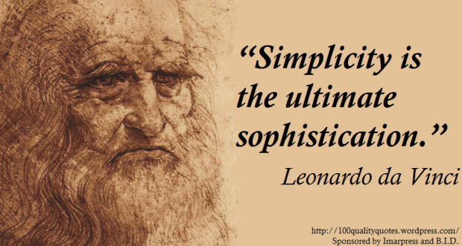
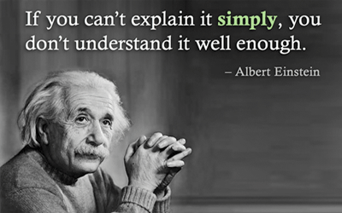
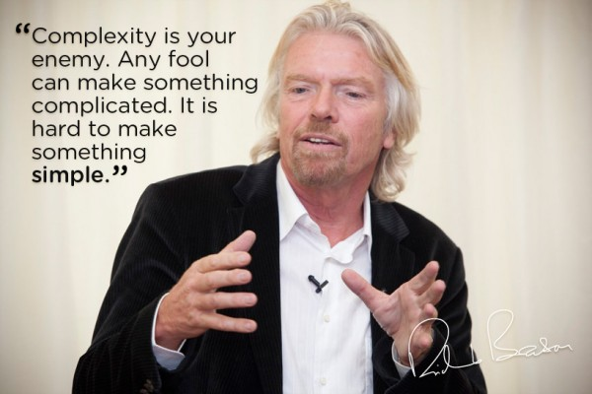
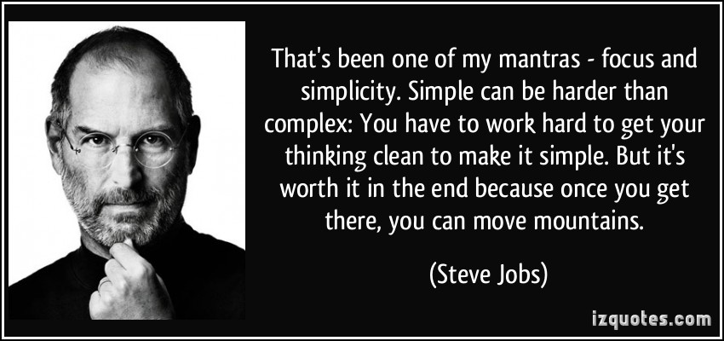
Simplicity

Slide 46
Interface Inheritance
Introduction to Computer Science
Shimon Schocken
IDC Herzliya
Lecture 12-2

